Slide 1
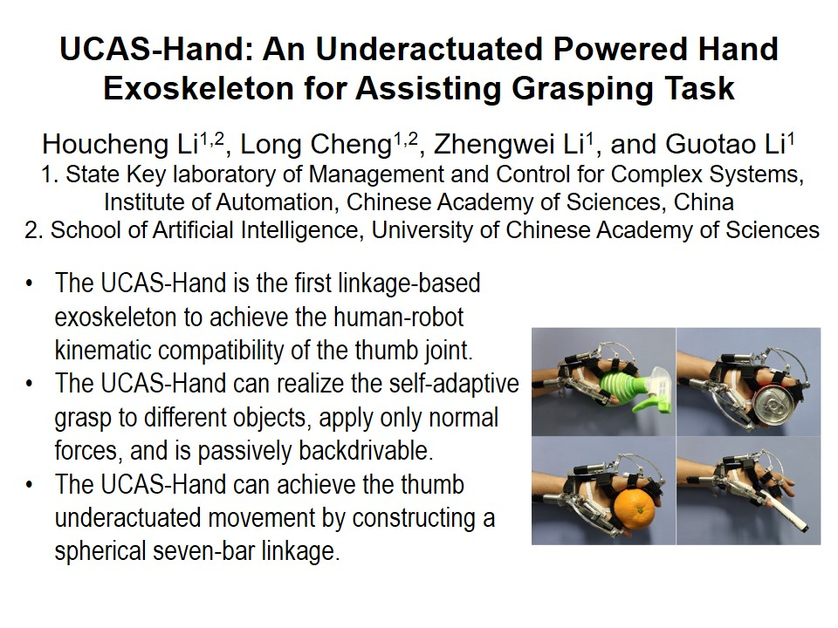
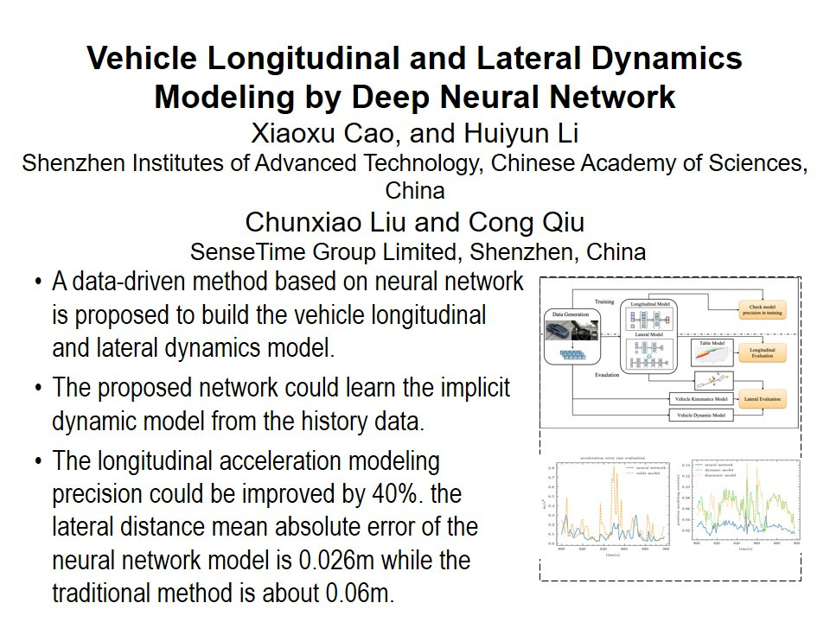
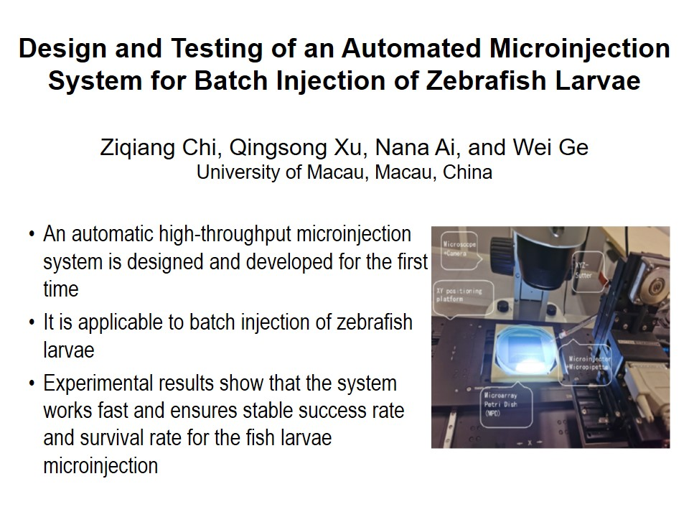
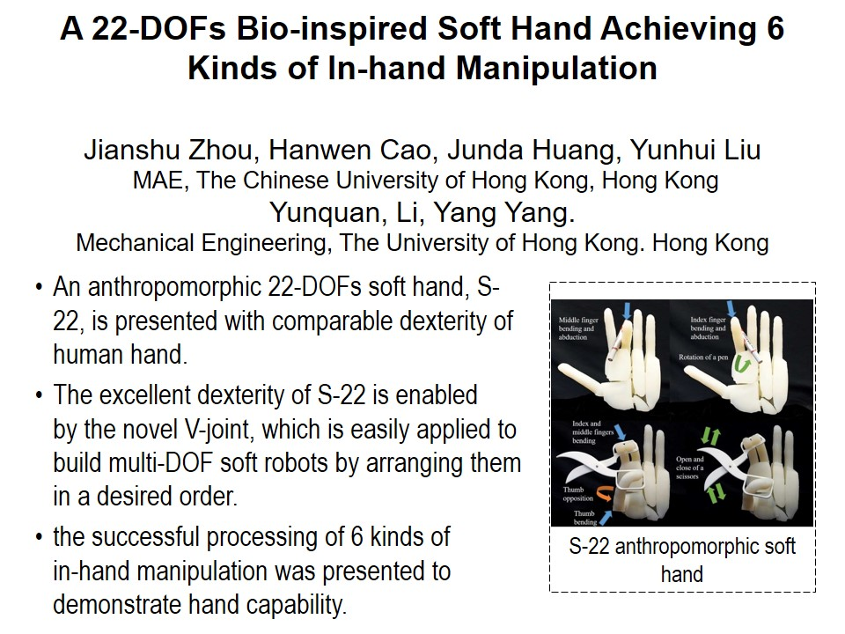
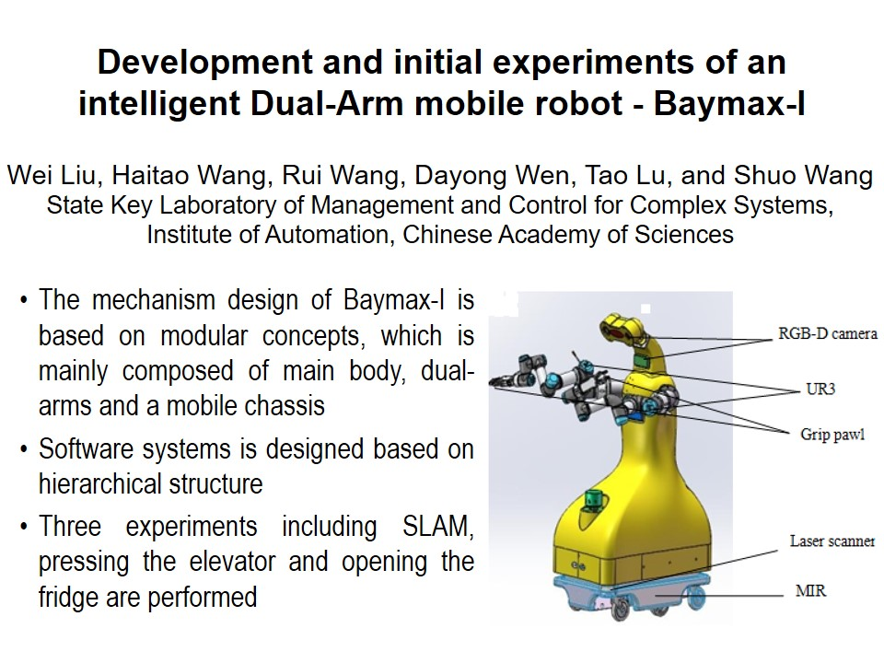
RCAR2021 Technical Sessions
ThA I:Best Paper
Session Chair:
Jingya Pavilion : July 15, 14:00 - 15:45, Thursday
14:00~14:15
14:15~14:30
14:30~14:45
14:45~15:00
15:00~15:15
T-1

Slide 2
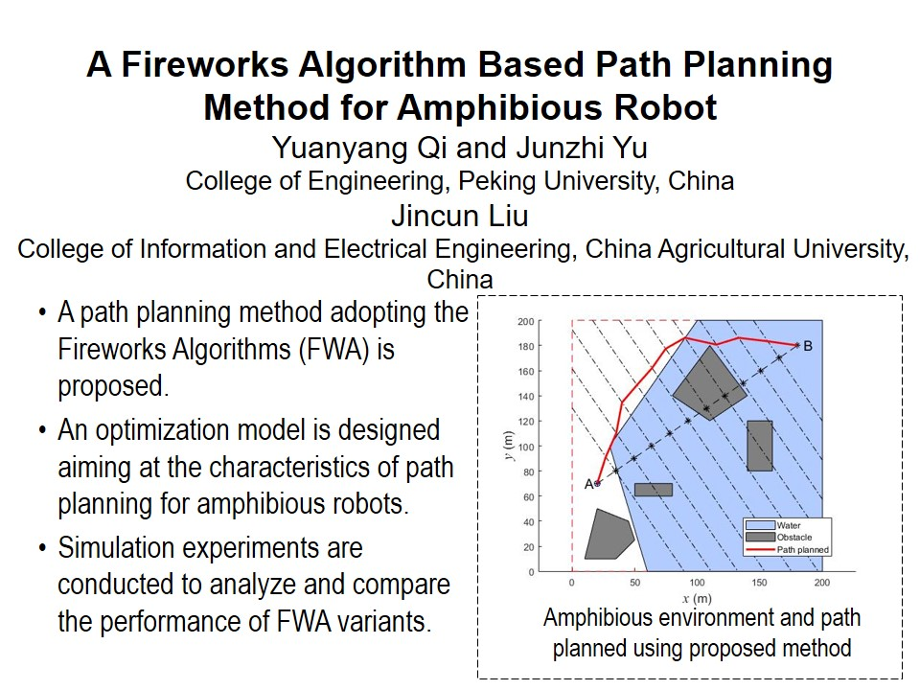
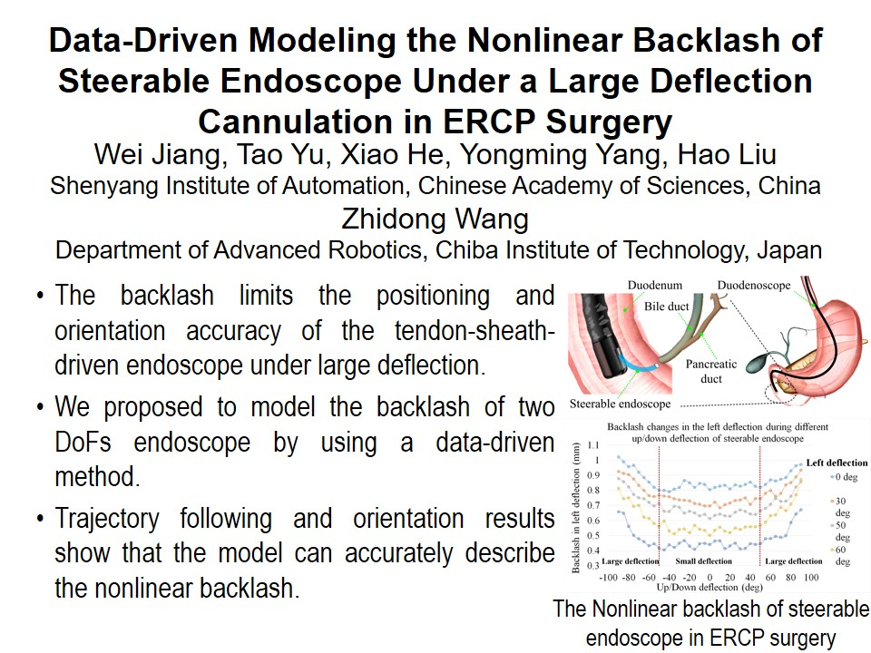
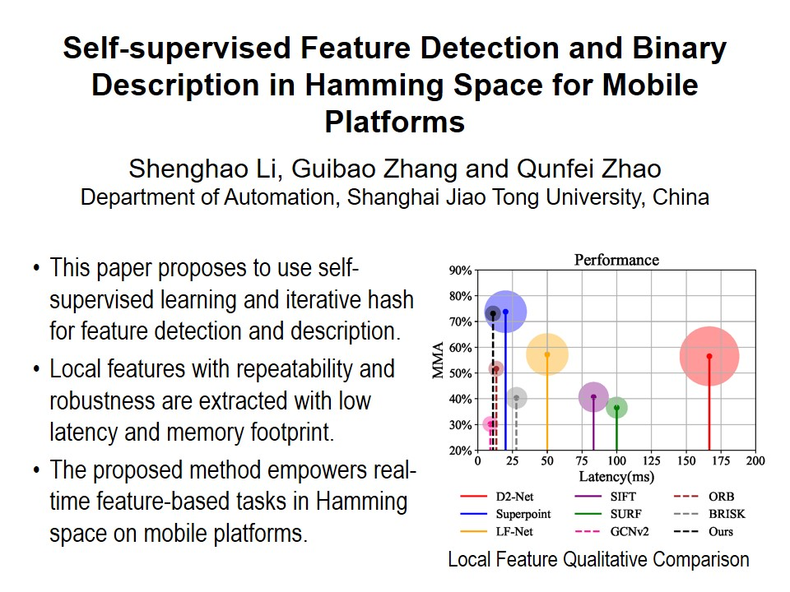
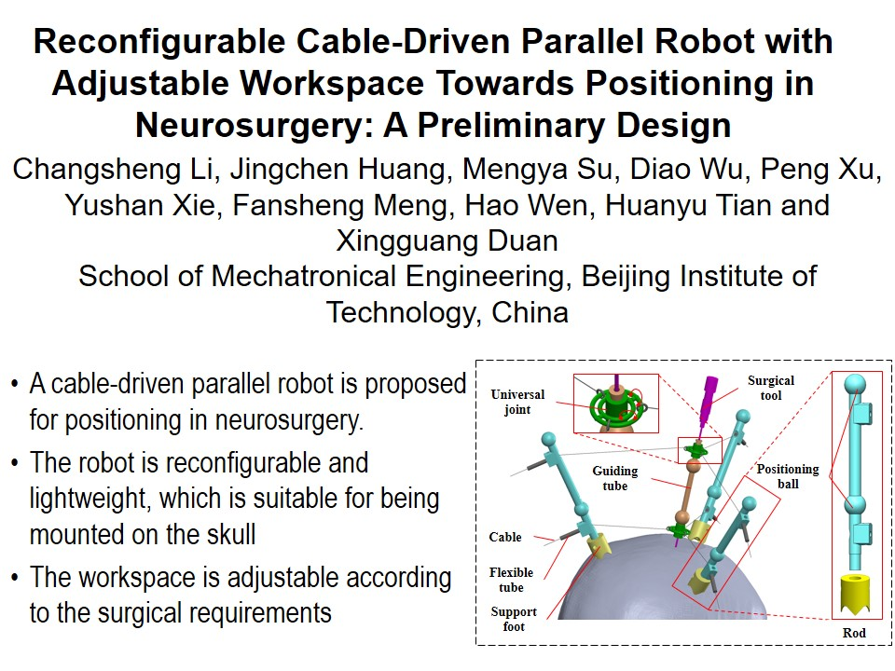
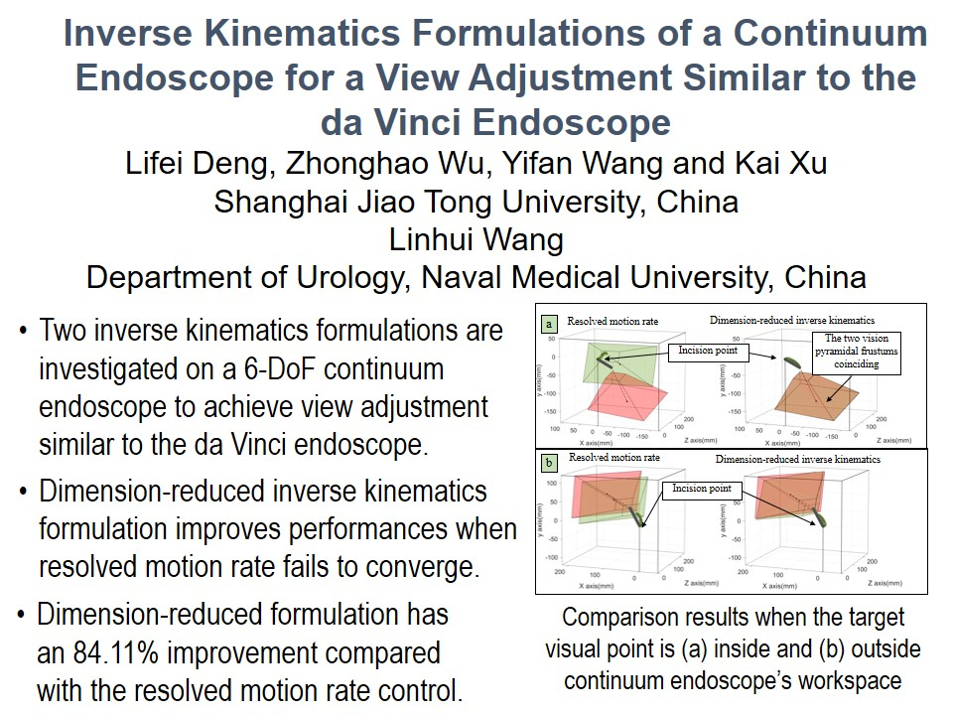
RCAR2021 Technical Sessions
ThB I:Best Paper In Robotics
Session Chair:
Lanting Pavilion : July 15, 14:00 - 15:45, Thursday
14:00~14:15
14:15~14:30
14:30~14:45
14:45~15:00
15:00~15:15
T-2

Slide 3
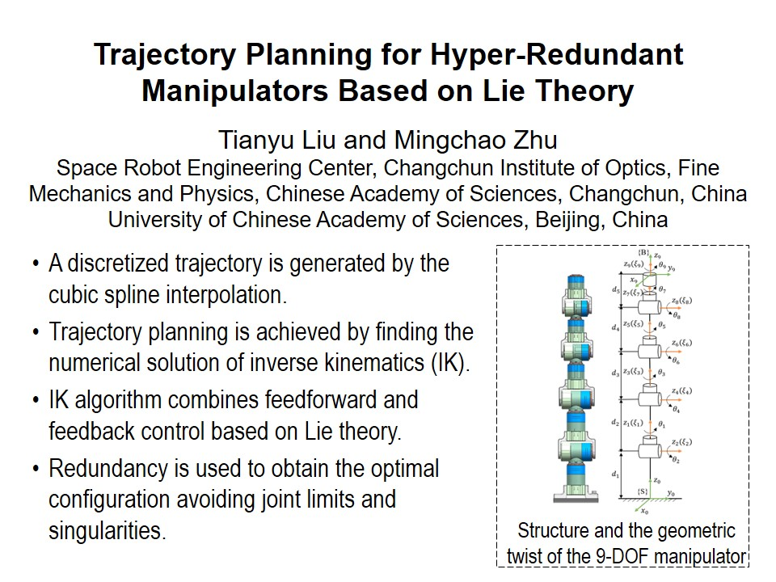
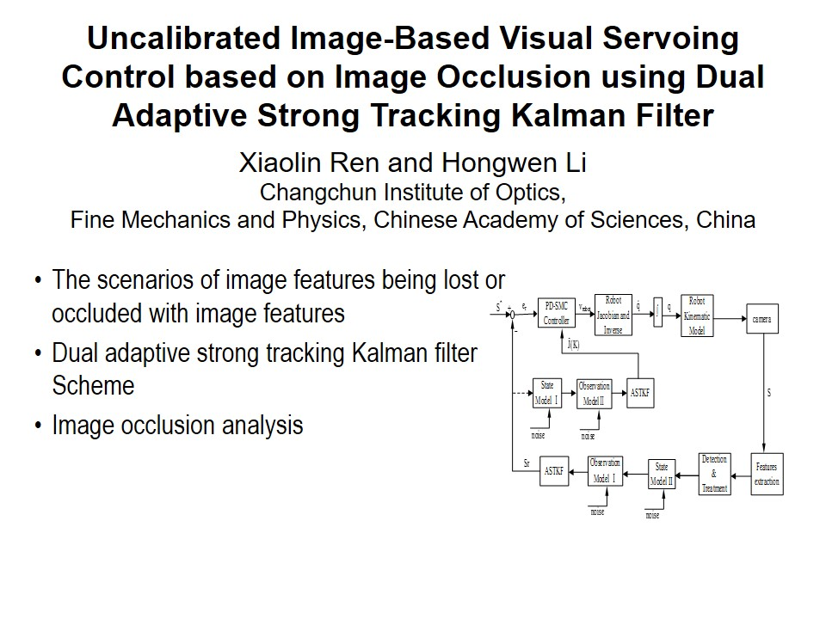
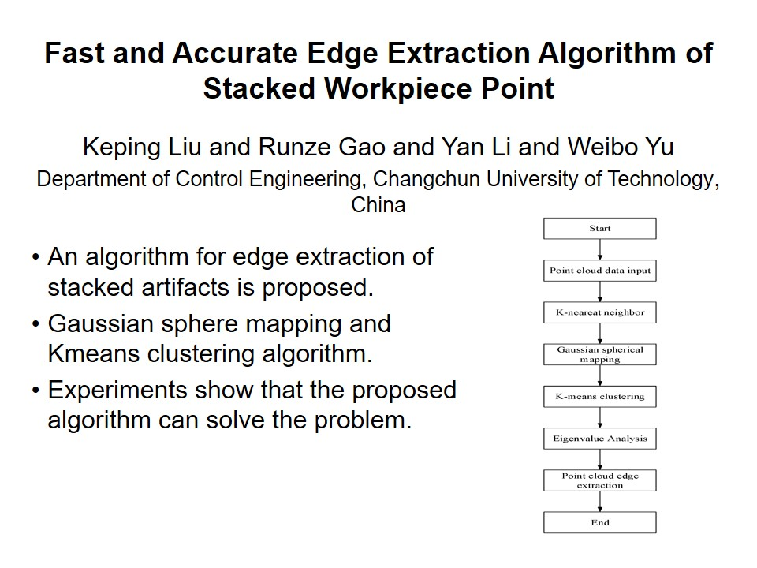
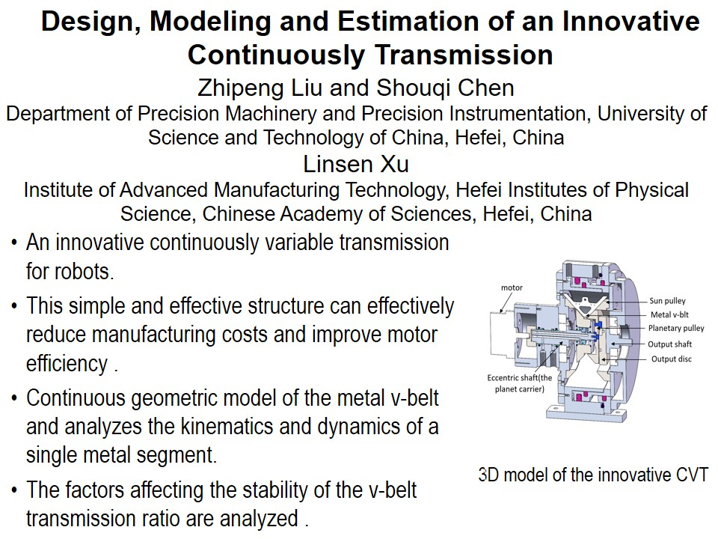
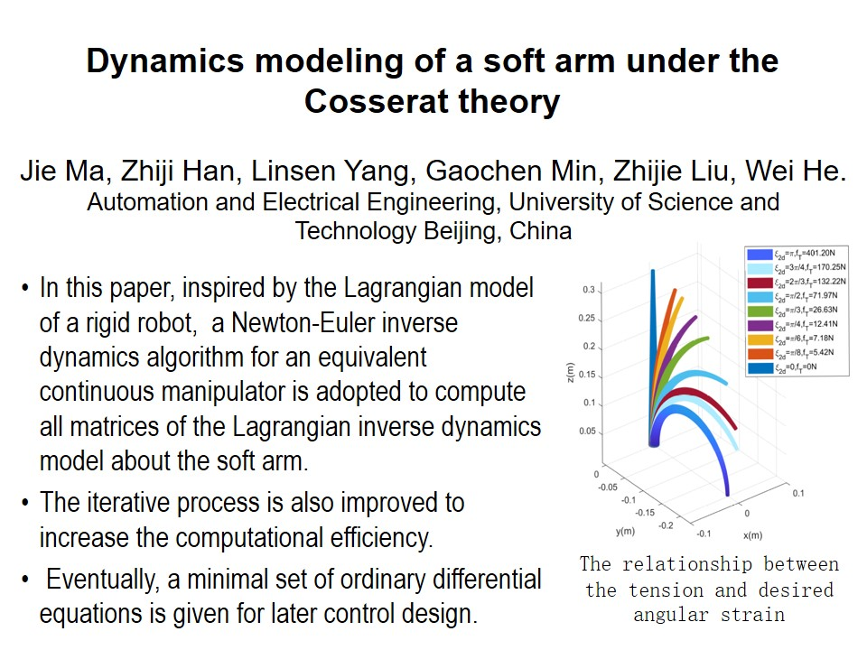
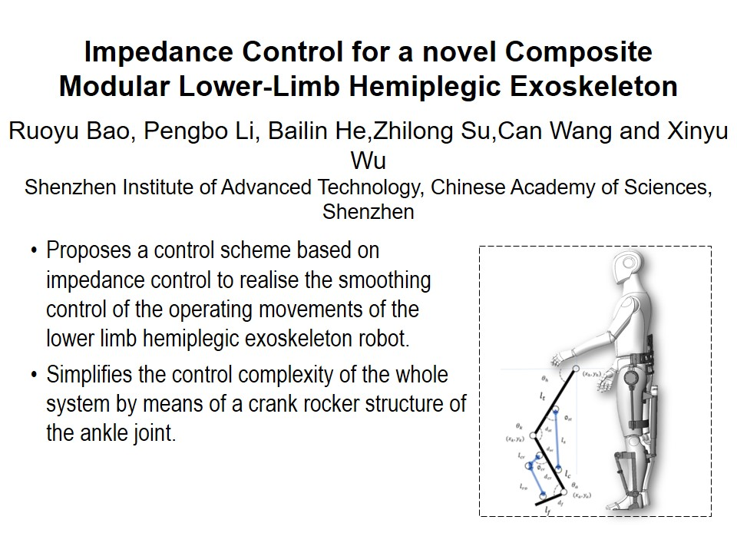
RCAR2021 Technical Sessions
ThC I:Robotics Control Ⅰ
Session Chair:
Meeting Room 1 : July 15, 14:00 - 15:45, Thursday
14:00~14:15
14:15~14:30
14:30~14:45
14:45~15:00
15:00~15:15
15:15~15:30
T-3

Slide 4
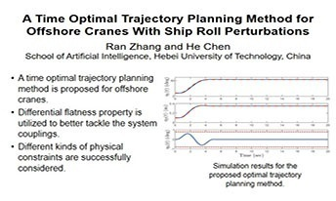
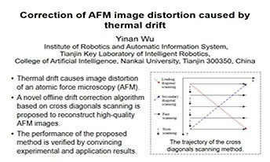
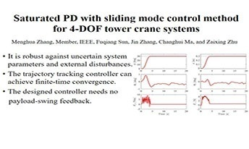
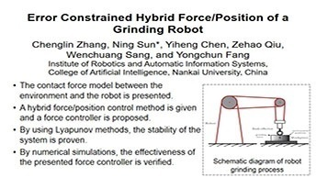
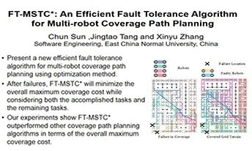
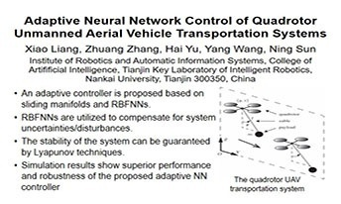
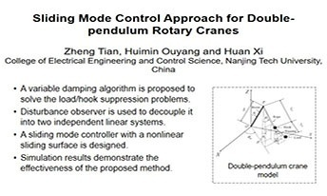
RCAR2021 Technical Sessions
ThD I:Soft robotic system I
Session Chair:
Meeting Room 2 : July 15, 14:00 - 15:45, Thursday
14:00~14:15
14:15~14:30
14:30~14:45
14:45~15:00
15:00~15:15
15:15~15:30
15:30~15:45
T-4

Slide 5
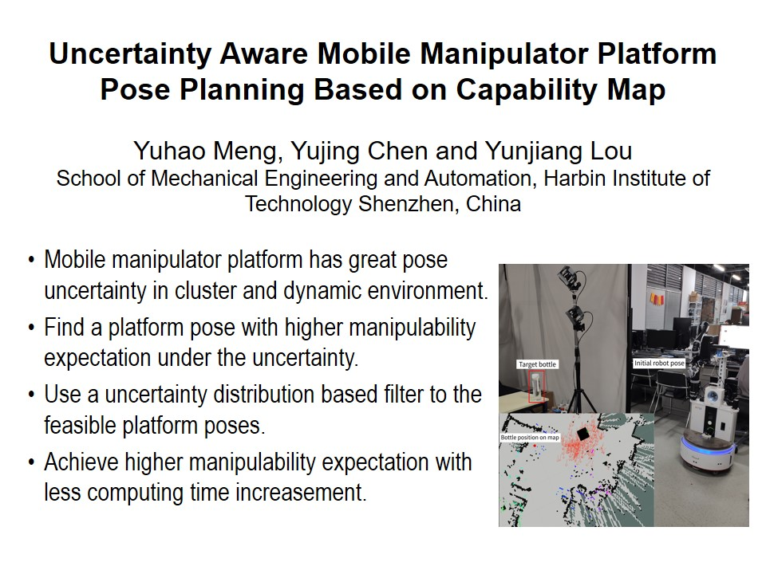
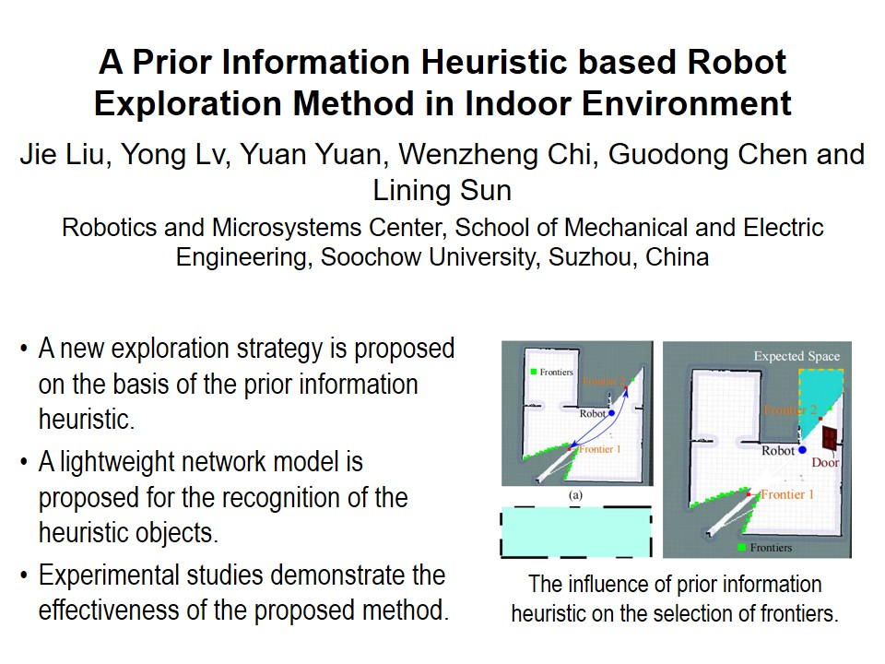
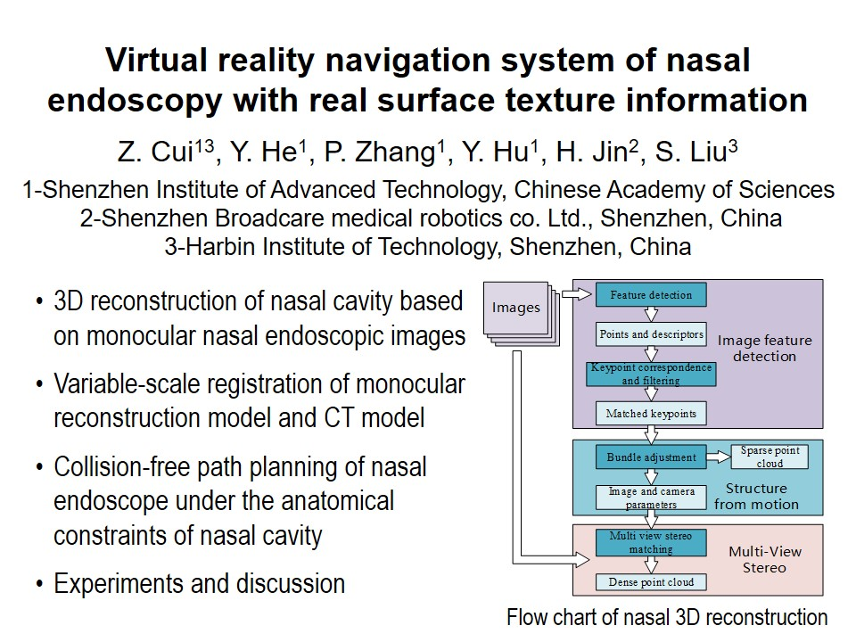
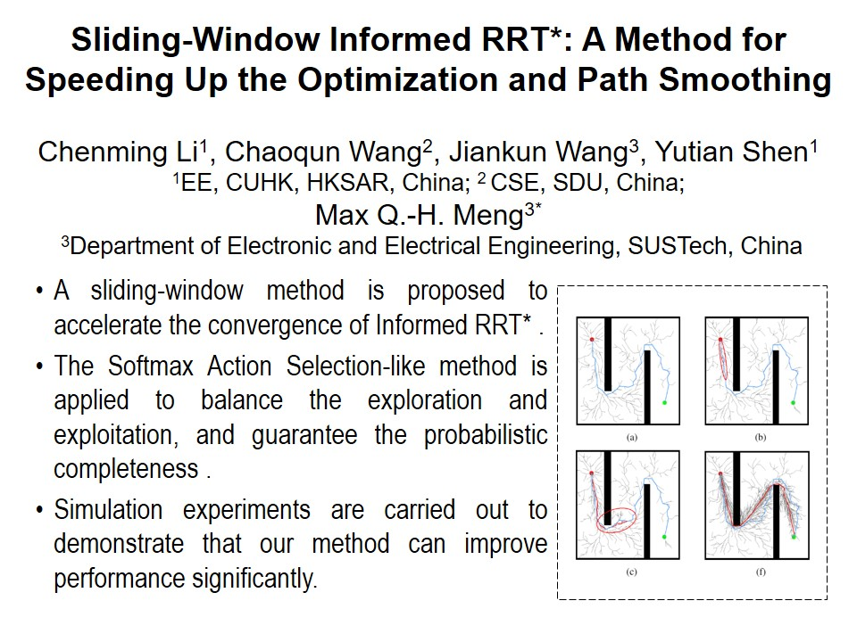
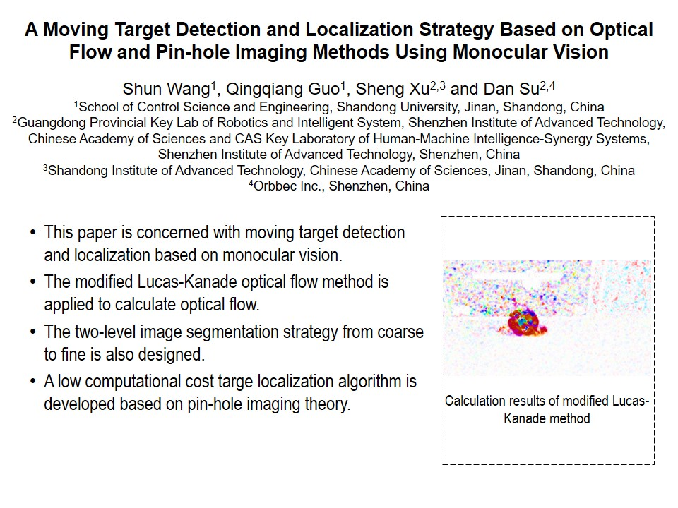
RCAR2021 Technical Sessions
ThA Ⅱ:Best Student Paper
Session Chair:
Jingya Pavilion : July 15, 16:15 - 18:00, Thursday
16:15~16:30
16:30~16:45
16:45~17:00
17:00~17:15
17:15~17:30
T-5

Slide 6
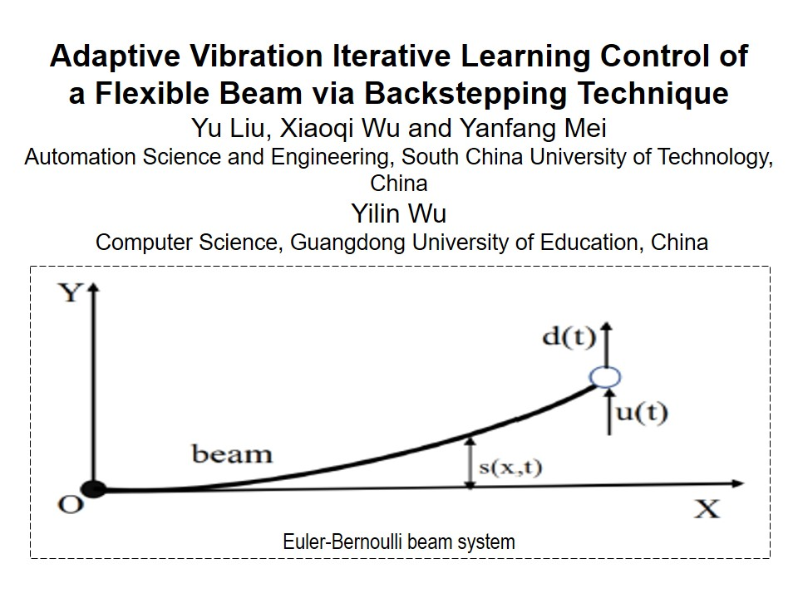
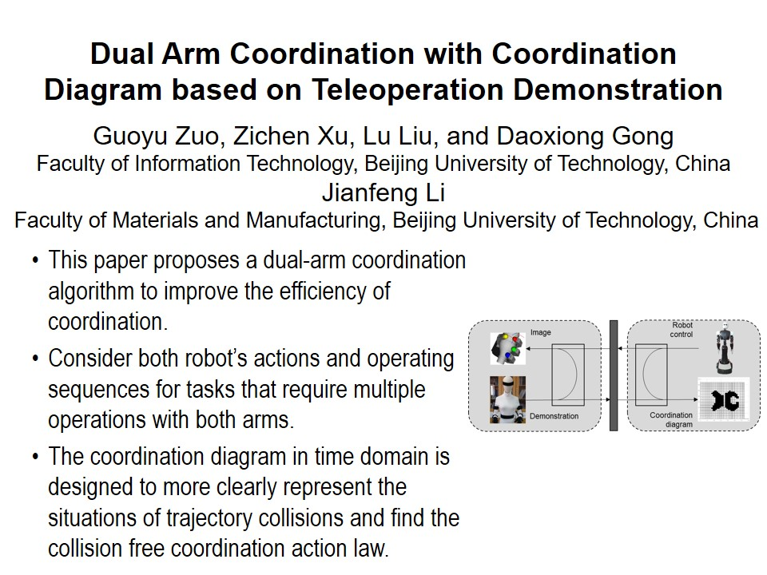
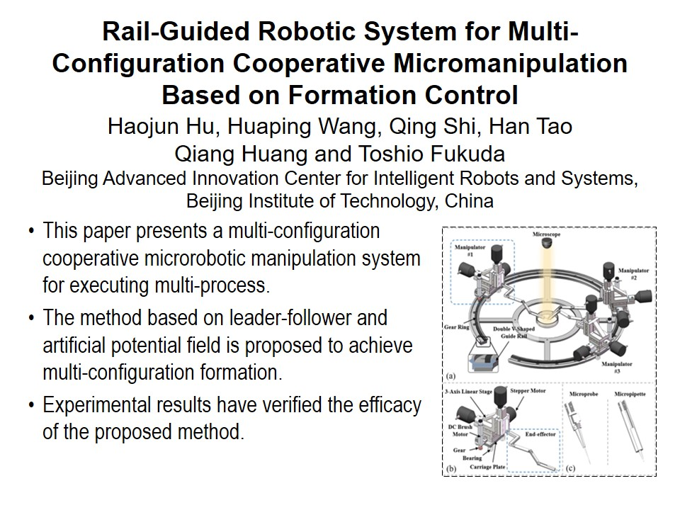
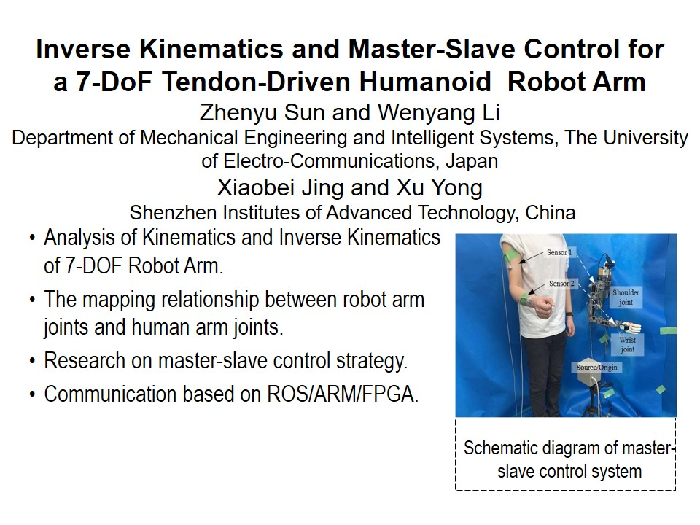
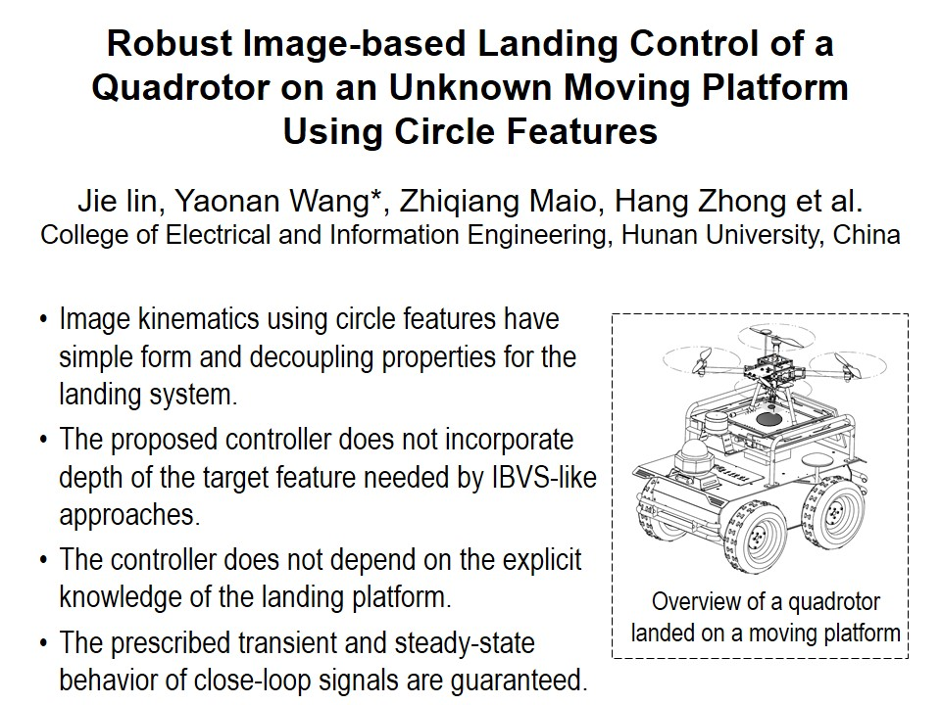
RCAR2021 Technical Sessions
ThB Ⅱ:Best Paper In Control
Session Chair:
Lanting Pavilion : July 15, 16:15 - 18:00, Thursday
16:15~16:30
16:30~16:45
16:45~17:00
17:00~17:15
17:15~17:30
T-6

Slide 7
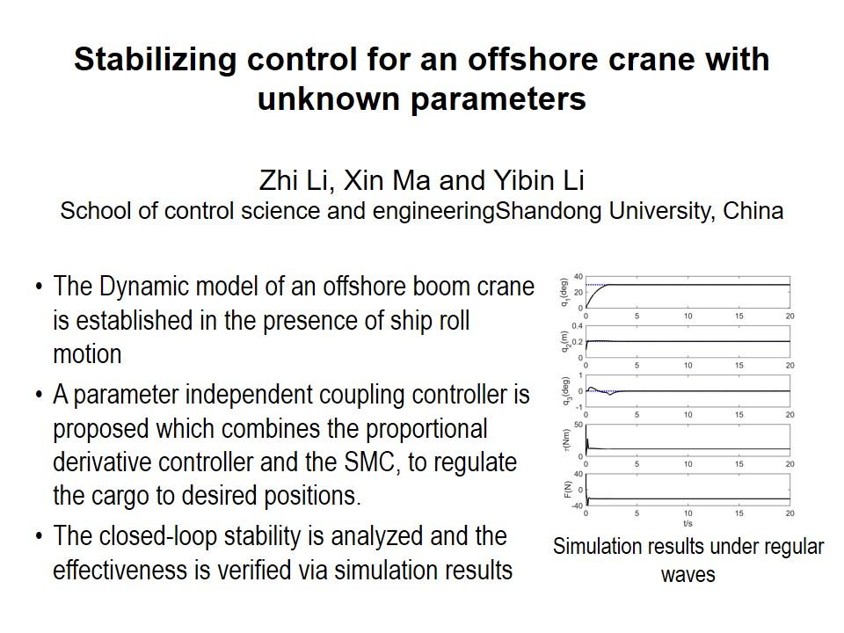
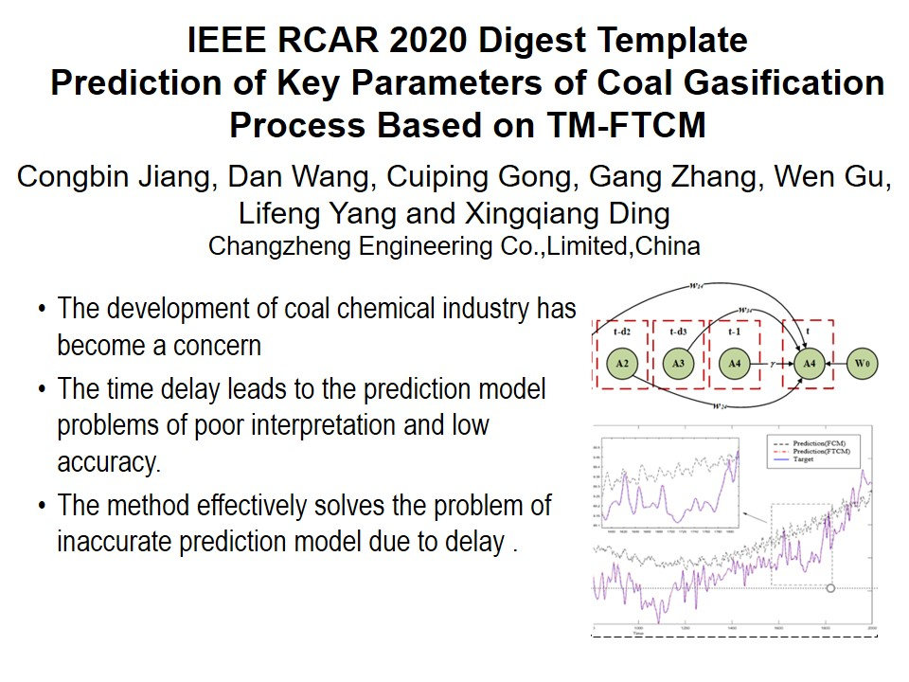
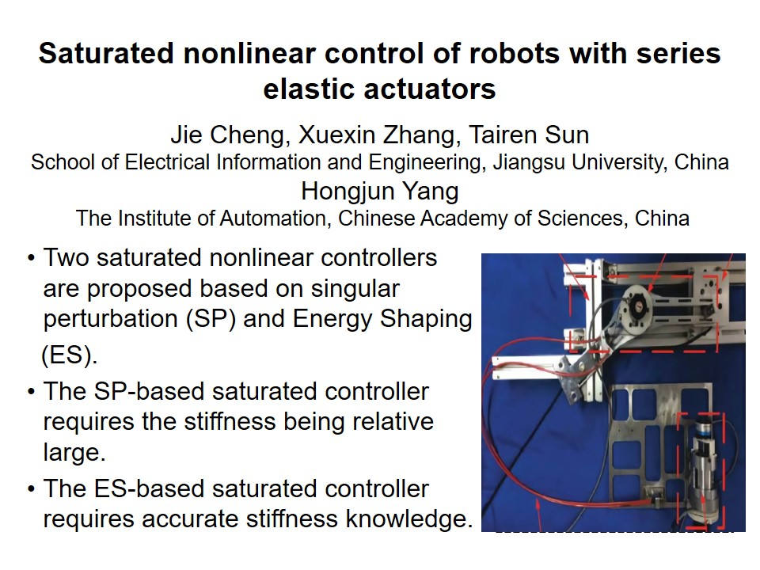

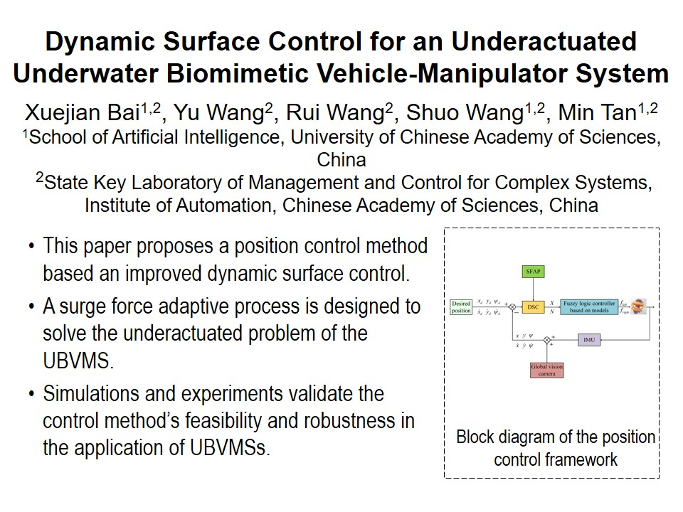
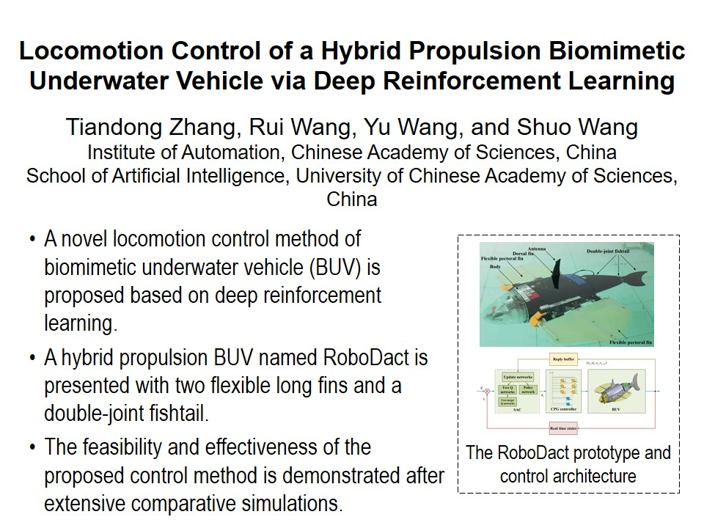
RCAR2021 Technical Sessions
ThC Ⅱ:Robotic Control II
Session Chair:
Meeting Room 1 : July 15, 16:15 - 18:00, Thursday
16:15~16:30
16:30~16:45
16:45~17:00
17:00~17:15
17:15~17:30
17:30~17:45
T-7

Slide 8
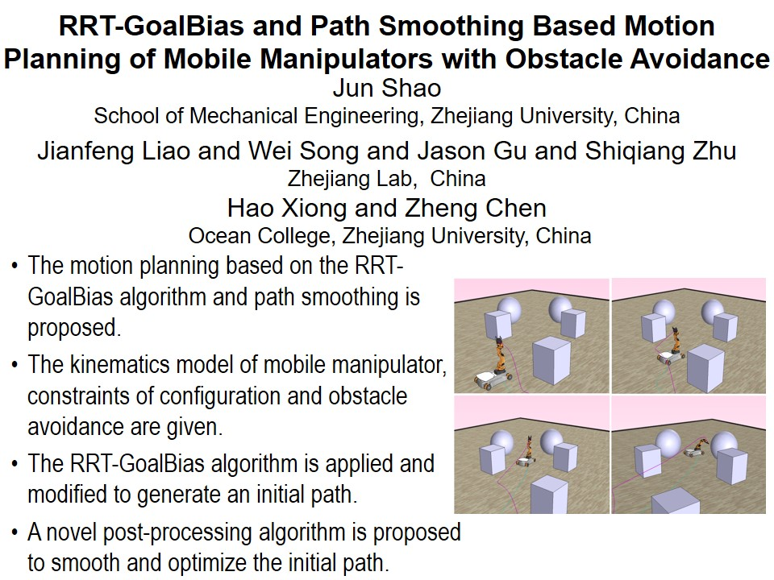
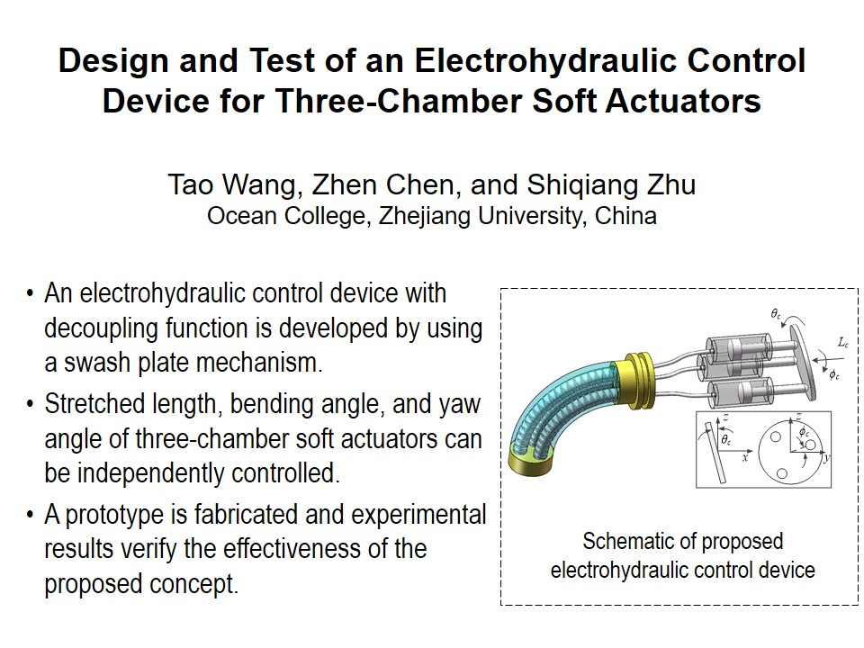
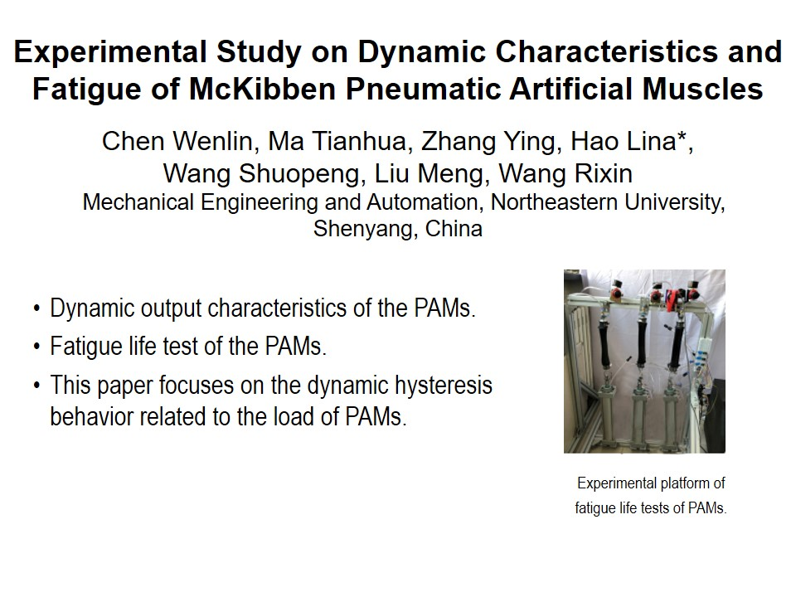
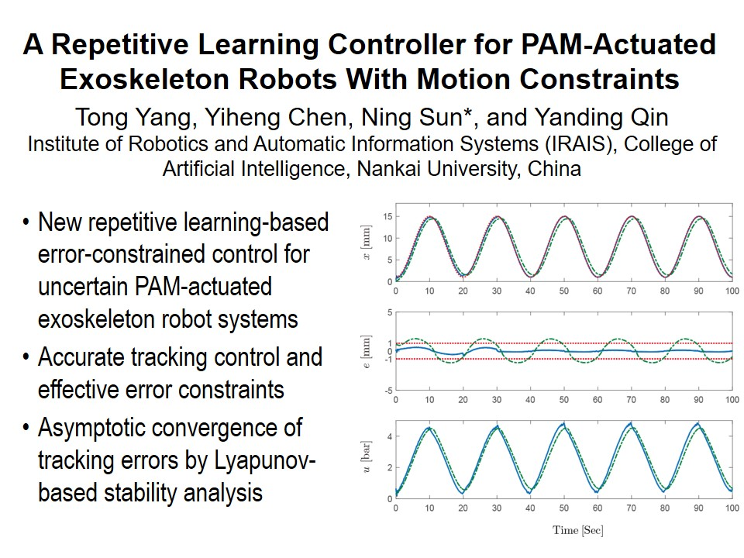
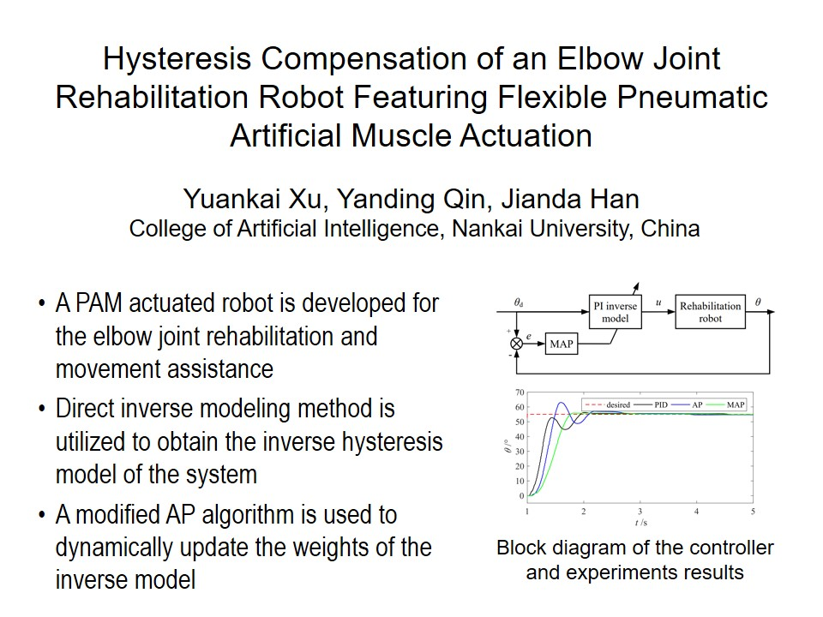
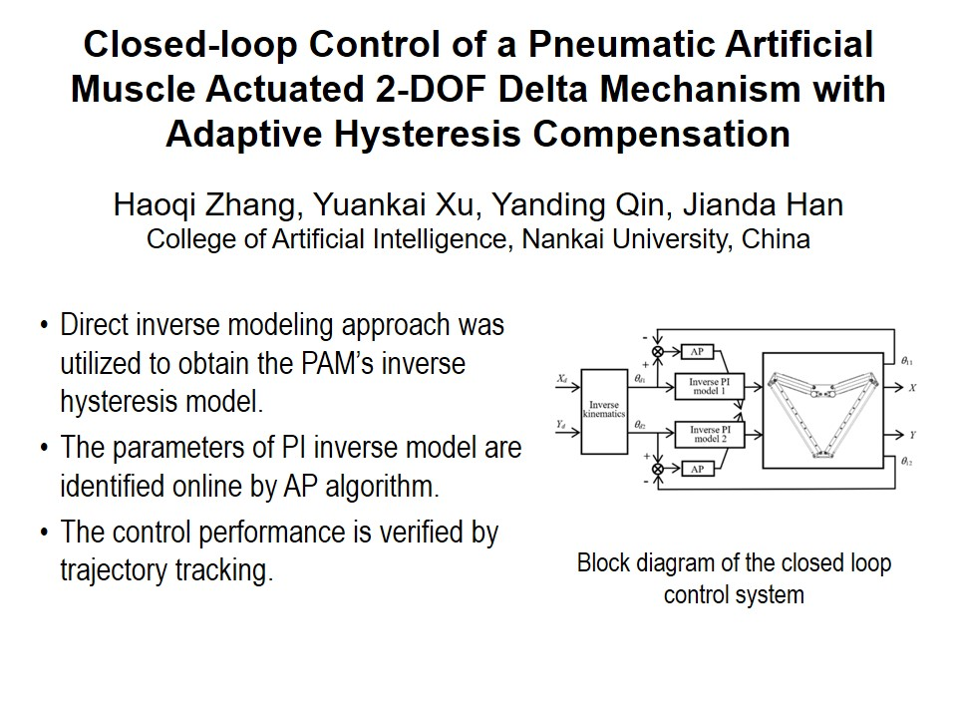
RCAR2021 Technical Sessions
ThD Ⅱ:Soft robotic system II
Session Chair:
Meeting Room 2 : July 15, 16:15 - 18:00, Thursday
16:15~16:30
16:30~16:45
16:45~17:00
17:00~17:15
17:15~17:30
17:30~17:45
T-8

Slide 9
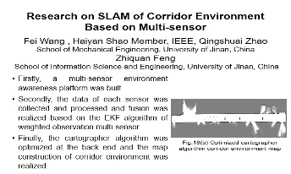
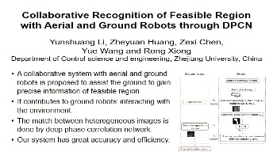
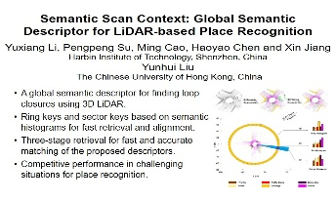
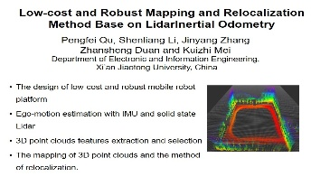
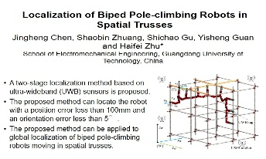
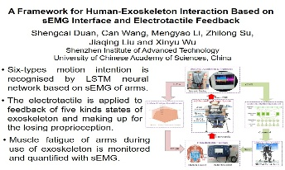

RCAR2021 Technical Sessions
FrA I:Sensing technology and recognition
Session Chair:
Jingya Pavilion : July 16, 14:00 - 15:45, Friday
14:00~14:15
14:15~14:30
14:30~14:45
14:45~15:00
15:00~15:15
15:15~15:30
15:30~15:45
T-9

Slide 10






RCAR2021 Technical Sessions
FrB I:Human-Machine Interface I
Session Chair:
Lanting Pavilion : July 16, 14:00 - 15:45, Friday
14:00~14:15
14:15~14:30
14:30~14:45
14:45~15:00
15:00~15:15
15:15~15:30
T-10

Slide 11






RCAR2021 Technical Sessions
FrC I:Robot Mechanism I
Session Chair:
Meeting Room 1 : July 16, 14:00 - 15:45, Friday
14:00~14:15
14:15~14:30
14:30~14:45
14:45~15:00
15:00~15:15
15:15~15:30
T-11

Slide 12








RCAR2021 Technical Sessions
FrD I:Vision I
Session Chair:
Meeting Room 2 : July 16, 14:00 - 15:45, Friday
14:00~14:15
14:15~14:30
14:30~14:45
14:45~15:00
15:00~15:15
15:15~15:30
15:30~15:45
T-12

Slide 13







RCAR2021 Technical Sessions
FrA Ⅱ:Mobile Robots I
Session Chair:
Jingya Pavilion : July 16, 16:15 - 18:00, Friday
16:15~16:30
16:30~16:45
16:45~17:00
17:00~17:15
17:15~17:30
17:30~17:45
17:45~18:00
T-13

Slide 14





RCAR2021 Technical Sessions
FrB Ⅱ:Human-Machine Interface II
Session Chair:
Lanting Pavilion : July 16, 16:15 - 18:00, Friday
16:15~16:30
16:30~16:45
16:45~17:00
17:00~17:15
17:15~17:30
T-14

Slide 15






RCAR2021 Technical Sessions
FrC Ⅱ:Robotic control III
Session Chair:
Meeting Room 1 : July 16, 16:15 - 18:00, Friday
16:15~16:30
16:30~16:45
16:45~17:00
17:00~17:15
17:15~17:30
17:30~17:45
T-15

Slide 16








RCAR2021 Technical Sessions
FrD Ⅱ:Learning I
Session Chair:
Meeting Room 2 : July 16, 16:15 - 18:00, Friday
16:15~16:30
16:30~16:45
16:45~17:00
17:00~17:15
17:15~17:30
17:30~17:45
17:45~18:00
18:00~18:15
T-16

Slide 17







RCAR2021 Technical Sessions
SaA I:Vision II
Session Chair:
Jingya Pavilion : July 17, 8:30 - 10:15, Saturday
8:30~8:45
8:45~9:00
9:00~9:15
9:15~9:30
9:30~9:45
9:45~10:00
10:00~10:15
T-17

Slide 18






RCAR2021 Technical Sessions
SaB I:Advanced Control I
Session Chair:
Lanting Pavilion : July 17, 8:30 - 10:15, Saturday
8:30~8:45
8:45~9:00
9:00~9:15
9:15~9:30
9:30~9:45
9:45~10:00
T-18

Slide 19







RCAR2021 Technical Sessions
SaC I:Learning II
Session Chair:
Meeting Room 1 : July 17, 8:30 - 10:15, Saturday
8:30~8:45
8:45~9:00
9:00~9:15
9:15~9:30
9:30~9:45
9:45~10:00
10:00~10:15
T-19

Slide 20







RCAR2021 Technical Sessions
SaD I:Robot Mechanism II
Session Chair:
Meeting Room 2 : July 17, 8:30 - 10:15, Saturday
8:30~8:45
8:45~9:00
9:00~9:15
9:15~9:30
9:30~9:45
9:45~10:00
10:00~10:15
T-20

Slide 21








RCAR2021 Technical Sessions
SaA Ⅱ:Vision III
Session Chair:
Jingya Pavilion : July 17, 10:45 - 12:30, Saturday
10:45~11:00
11:00~11:15
11:15~11:30
11:30~11:45
11:45~12:00
12:00~12:15
12:15~12:30
12:30~12:45
T-21

Slide 22






RCAR2021 Technical Sessions
SaB Ⅱ:Advanced Control II
Session Chair:
Lanting Pavilion : July 17, 10:45 - 12:30, Saturday
10:45~11:00
11:00~11:15
11:15~11:30
11:30~11:45
11:45~12:00
12:00~12:15
T-22

Slide 23







RCAR2021 Technical Sessions
SaC Ⅱ:Planning and Navigation
Session Chair:
Meeting Room 1 : July 17, 10:45 - 12:30, Saturday
10:45~11:00
11:00~11:15
11:15~11:30
11:30~11:45
11:45~12:00
12:00~12:15
12:15~12:30
T-23

Slide 24






RCAR2021 Technical Sessions
SaD Ⅱ:Robotic Control IV
Session Chair:
Meeting Room 2 : July 17, 10:45 - 12:30, Saturday
10:45~11:00
11:00~11:15
11:15~11:30
11:30~11:45
11:45~12:00
12:00~12:15
T-24

Slide 25







RCAR2021 Technical Sessions
SuA I:Vision I
Session Chair:
Online : July 18, 8:30 - 10:15, Sunday
8:30~8:45
8:45~9:00
9:00~9:15
9:15~9:30
9:30~9:45
9:45~10:00
10:00~10:15
T-25

Slide 26








RCAR2021 Technical Sessions
SuB I:Modelling I
Session Chair:
Online : July 18, 8:30 - 10:15, Sunday
8:30~8:45
8:45~9:00
9:00~9:15
9:15~9:30
9:30~9:45
9:45~10:00
10:00~10:15
10:15~10:30
T-26

Slide 27








RCAR2021 Technical Sessions
SuC I:Robotic Control
Session Chair:
Online : July 18, 10:45 - 12:30, Sunday
10:45~11:00
11:00~11:15
11:15~11:30
11:30~11:45
11:45~12:00
12:00~12:15
12:15~12:30
12:30~12:45
T-27

Slide 28







RCAR2021 Technical Sessions
SuD I:Mobile robots I
Session Chair:
Online : July 18, 10:45 - 12:30, Sunday
10:45~11:00
11:00~11:15
11:15~11:30
11:30~11:45
11:45~12:00
12:00~12:15
12:15~12:30
T-28

Slide 29








RCAR2021 Technical Sessions
SuA Ⅱ:Advanced Control I
Session Chair:
Online : July 18, 14:00 - 15:45, Sunday
14:00~14:15
14:15~14:30
14:30~14:45
14:45~15:00
15:00~15:15
15:15~15:30
15:30~15:45
15:45~16:00
T-29

Slide 30








RCAR2021 Technical Sessions
SuB Ⅱ:Wearable robots
Session Chair:
Online : July 18, 14:00 - 15:45, Sunday
14:00~14:15
14:15~14:30
14:30~14:45
14:45~15:00
15:00~15:15
15:15~15:30
15:30~15:45
15:45~16:00
T-30

Slide 31







RCAR2021 Technical Sessions
SuC Ⅱ:Vision II
Session Chair:
Online : July 18, 16:15 - 18:00, Sunday
16:15~16:30
16:30~16:45
16:45~17:00
17:00~17:15
17:15~17:30
17:30~17:45
17:45~18:00
T-31

Slide 32








RCAR2021 Technical Sessions
SuD Ⅱ:Learning
Session Chair:
Online : July 18, 16:15 - 18:00, Sunday
16:15~16:30
16:30~16:45
16:45~17:00
17:00~17:15
17:15~17:30
17:30~17:45
17:45~18:00
18:00~18:15
T-32

Slide 33







RCAR2021 Technical Sessions
MoA I:Vision III
Session Chair:
Online : July 19, 8:30 - 10:15, Monday
8:30~8:45
8:45~9:00
9:00~9:15
9:15~9:30
9:30~9:45
9:45~10:00
10:00~10:15
T-33

Slide 34







RCAR2021 Technical Sessions
MoB I:Advanced Control II
Session Chair:
Online : July 19, 8:30 - 10:15, Monday
8:30~8:45
8:45~9:00
9:00~9:15
9:15~9:30
9:30~9:45
9:45~10:00
10:00~10:15
T-34

Slide 35







RCAR2021 Technical Sessions
MoC I:Robotic Control II
Session Chair:
Online : July 19, 10:45 - 12:30, Monday
10:45~11:00
11:00~11:15
11:15~11:30
11:30~11:45
11:45~12:00
12:00~12:15
12:15~12:30
T-35

Slide 36








RCAR2021 Technical Sessions
MoD I:Robot Mechanism
Session Chair:
Online : July 19, 10:45 - 12:30, Monday
10:45~11:00
11:00~11:15
11:15~11:30
11:30~11:45
11:45~12:00
12:00~12:15
12:15~12:30
12:30~12:45
T-36

Slide 37








RCAR2021 Technical Sessions
MoA Ⅱ:Vision IV
Session Chair:
Online : July 19, 14:00 - 15:45, Monday
14:00~14:15
14:15~14:30
14:30~14:45
14:45~15:00
15:00~15:15
15:15~15:30
15:30~15:45
15:45~16:00
T-37

Slide 38







RCAR2021 Technical Sessions
MoB Ⅱ:Robotic Control III
Session Chair:
Online : July 19, 14:00 - 15:45, Monday
14:00~14:15
14:15~14:30
14:30~14:45
14:45~15:00
15:00~15:15
15:15~15:30
15:30~15:45
T-38

Slide 39






RCAR2021 Technical Sessions
MoC Ⅱ:Robotic Control IV
Session Chair:
Online : July 19, 16:15 - 18:00, Monday
16:15~16:30
16:30~16:45
16:45~17:00
17:00~17:15
17:15~17:30
17:30~17:45
T-39

